Slide 1

Lecture 01 – Introduction to NLP
Baojian Zhou
DATA130030.01 (自然语言处理)
School of Data Science, Fudan University
02/22/2023

Slide 2
Outline
Introduction to NLP
Basics for Python and NLTK
Regular Expression & Edit distance

Slide 3

About me
Email: bjzhou@fudan.edu.cn
Website: https://baojian.github.io/
WeChat: 19102180506
Locations:
新金博1301室（实验室）
新金博1307室（办公室）
Research interests:
Data mining, Machine learning on graphs

Slide 4
Outline
Introduction to NLP
Basics for Python and NLTK
Regular Expression & Edit distance

Slide 5
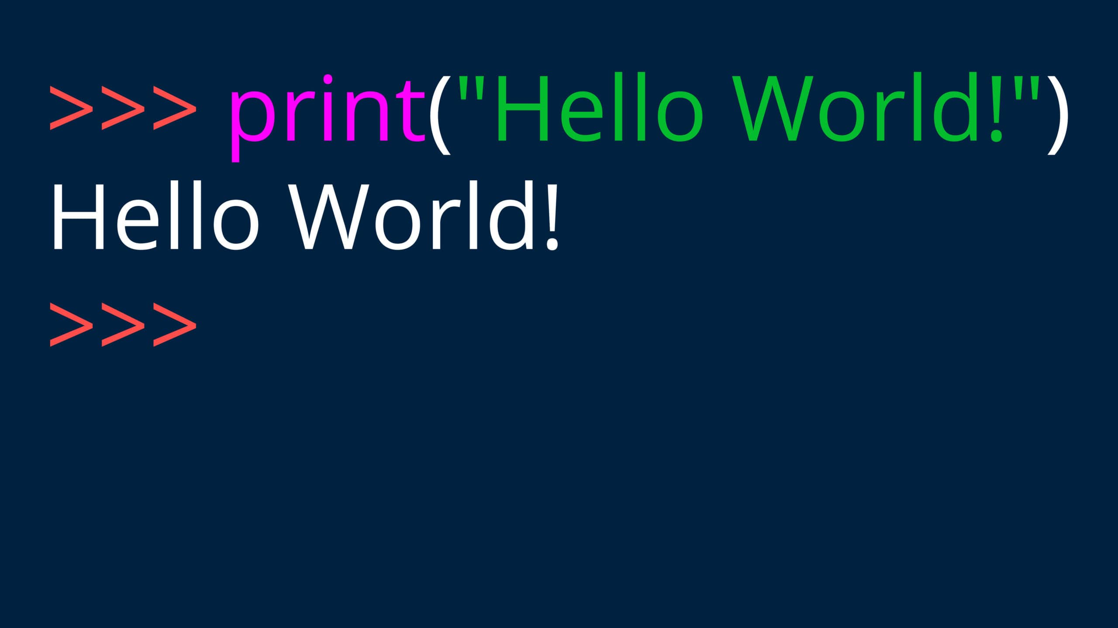
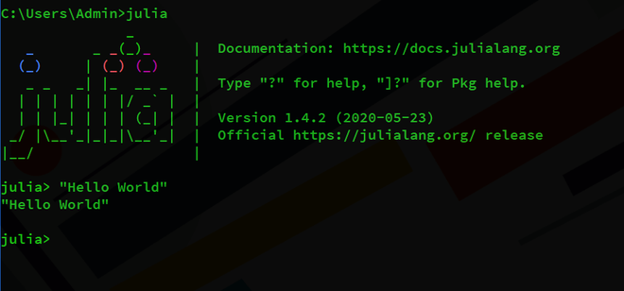
What is natural language?
A structured system of communication used by humans
今天天气真好！
The weather is so nice today!
今日は天気がいいです！
Formal Language (e.g., Programming languages)
#include <stdio.h>
int main(void) {
printf(“Hello, world!\n”);
}

Slide 6
Natural Language Processing (NLP)
语言学、计算机科学和人工智能的一个子领域，涉及计算机与人类语言的交互，特别是如何对计算机进行编程以处理和分析大量的自然语言数据。
Teach computers how to understand and generate human languages
Other names
Computational Linguistics (计算语言学)
Natural Language Engineering (自然语言工程)
Human Language Technology (人类语言技术)
AI
ML
NLP
DL
NLP in AI

Slide 7
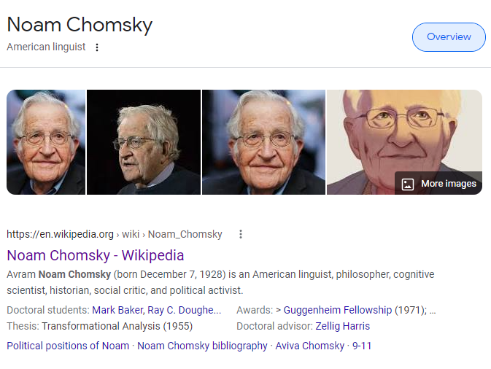
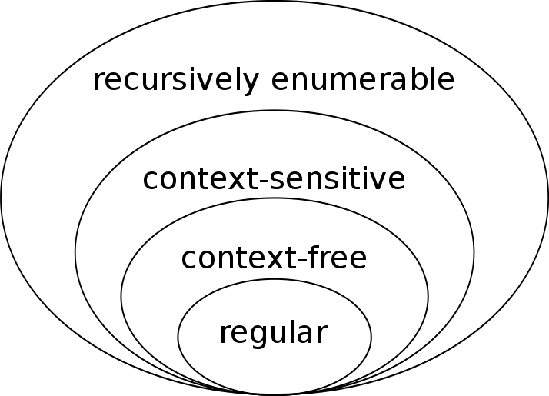
NLP from linguistics

Slide 8
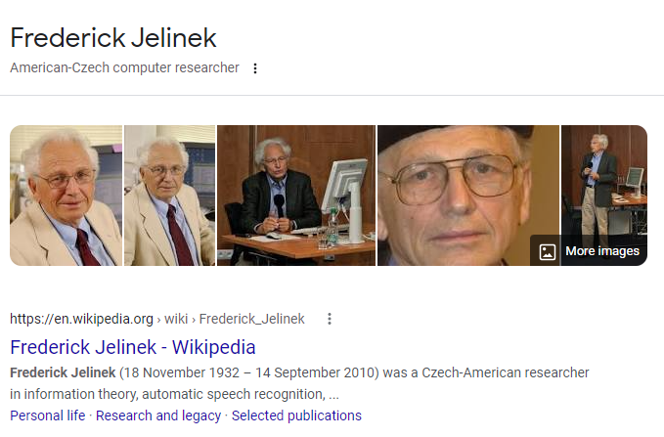
NLP is not Linguistic
“Every time I fire a linguist, the performance of the speech recognizer goes up.” -- Frederick Jelinek

Slide 9
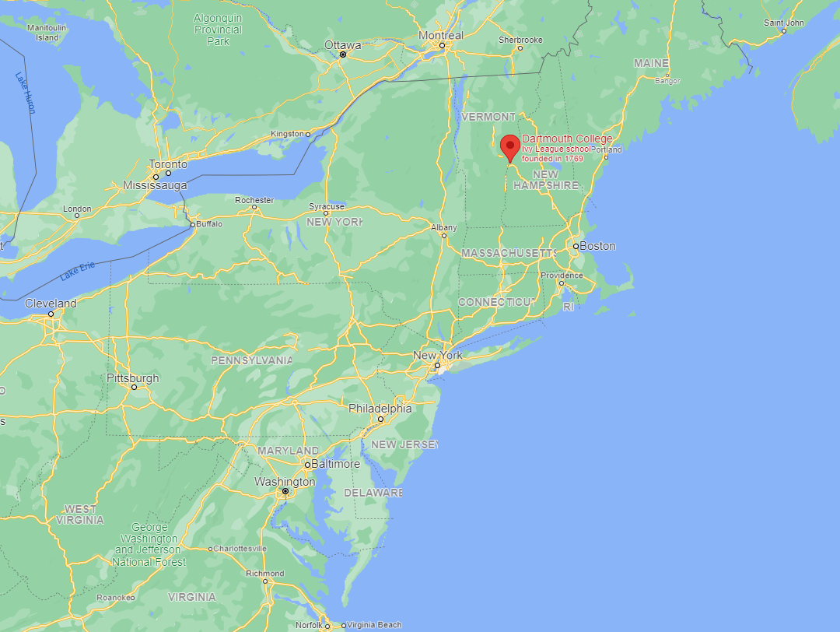


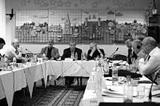
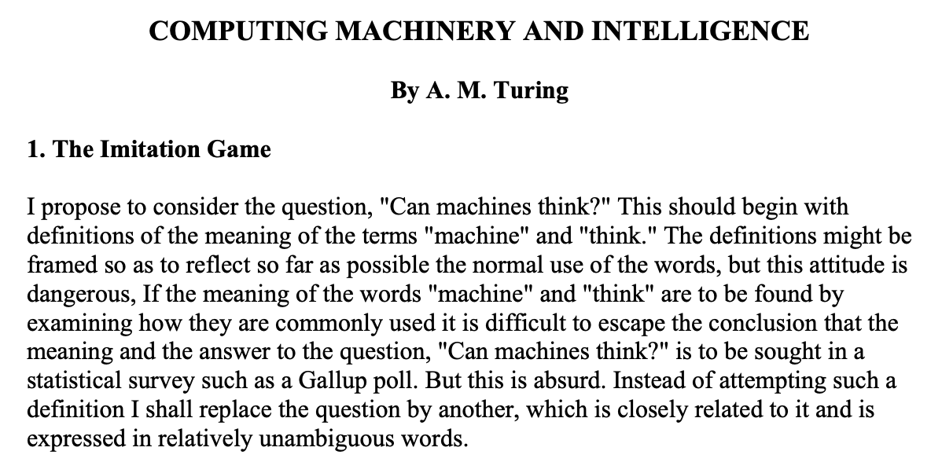
NLP history and AI
Dartmouth Conference, 1956
The Turing Test
Alan Turing, 1912-1954
NLP: Language Understanding and Generation

Slide 10
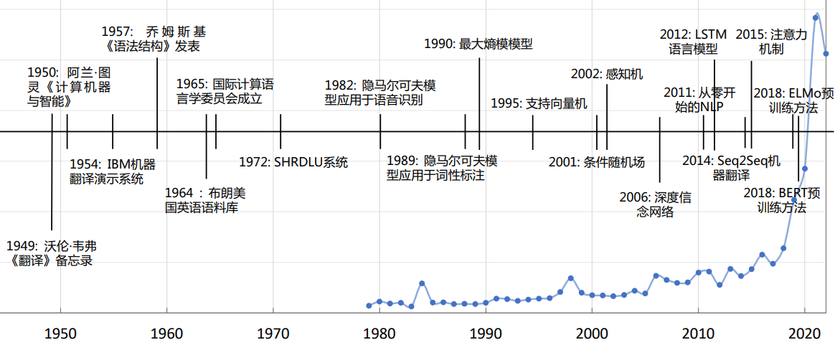
NLP Timeline
Number of papers in ACL by year

Slide 11
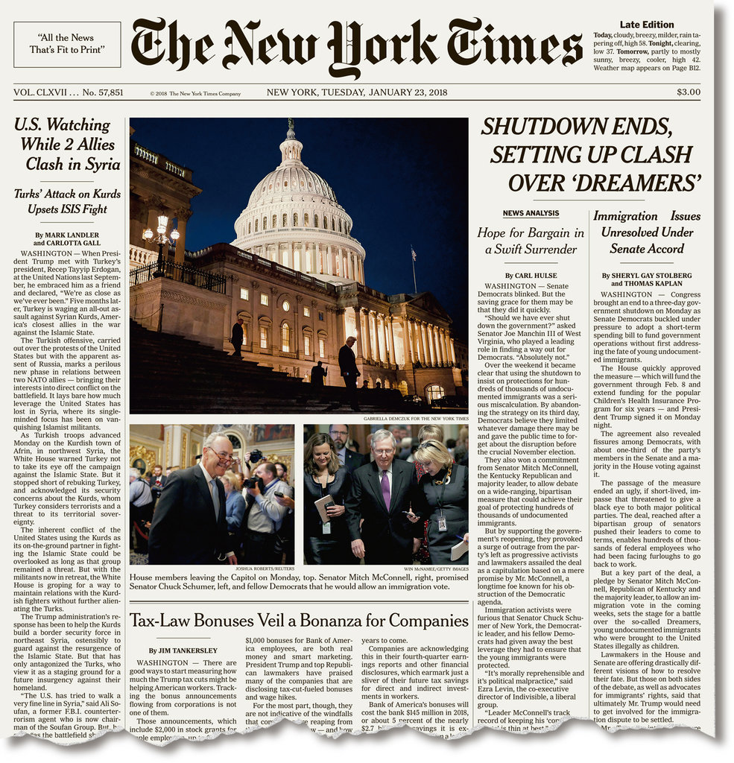

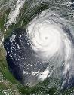



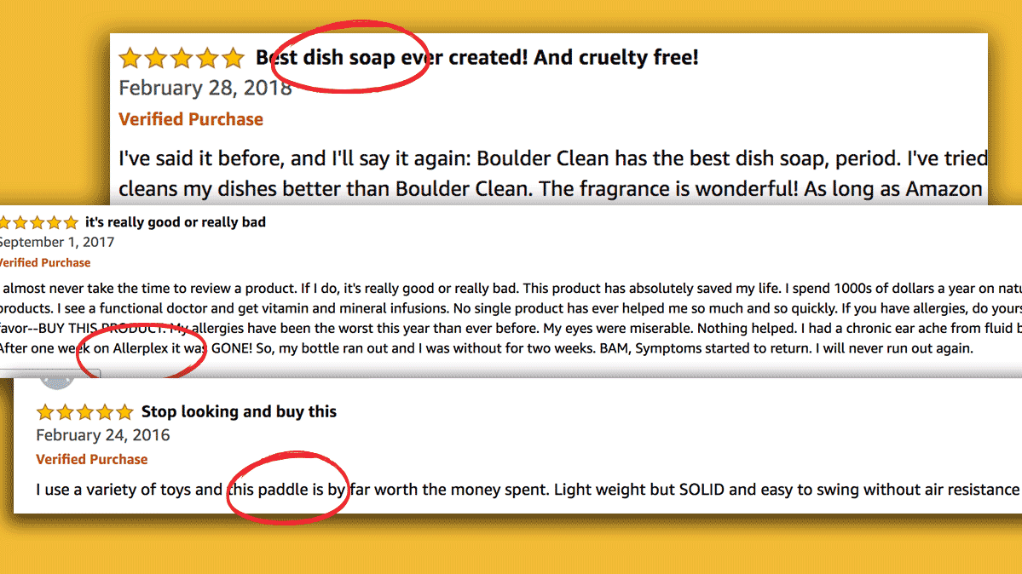

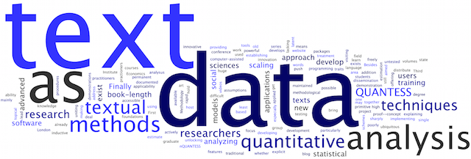

Text data
Topics:
People
Events
Products
Sources:
Blogs
Microblogs
Forums
Reviews

Slide 12




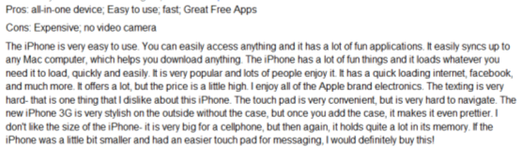

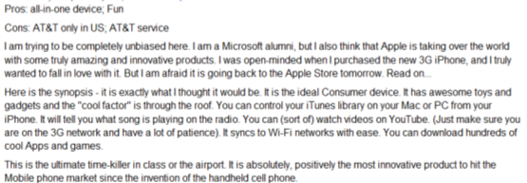
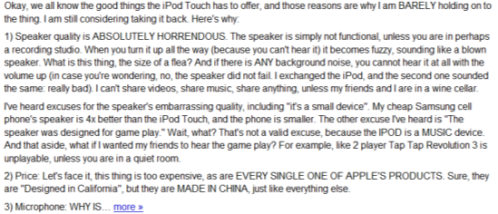
Humans as subjective “Sensors”
Sense
Report
Real World
Sensor
Data
Weather
Thermometer
3°C , 15°F
Locations
Geo Sensor
41°N, 120°W
Networks
Network Sensor
01000100011100
Perceive
Express
“Human Sensor”

Slide 13
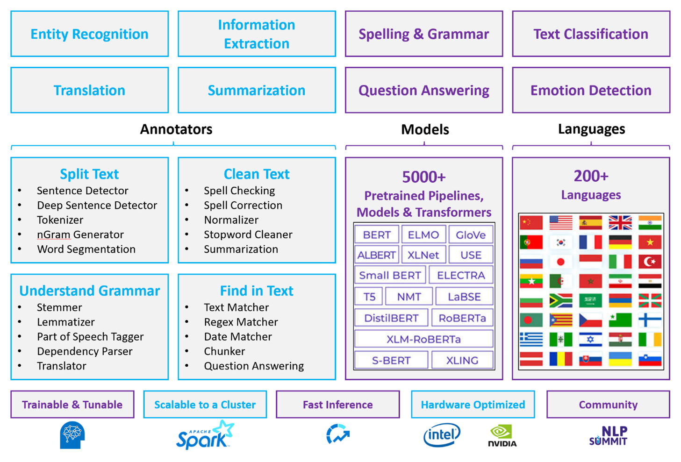
Many NLP tasks
Natural language processing technology

Slide 14


Tasks - Sentiment Analysis
Attributes
Zoom
Affordability
Size and weight
Flash
Ease of use
Algorithm
Positive
Negative
✓
Nice and compact to carry!
Since the camera is small and light, I won't need to carry around those heavy, bulky professional cameras either!
The camera feels flimsy, is plastic and very light in weight you have to be very delicate in the handling of this camera.
✓
✗

Slide 15
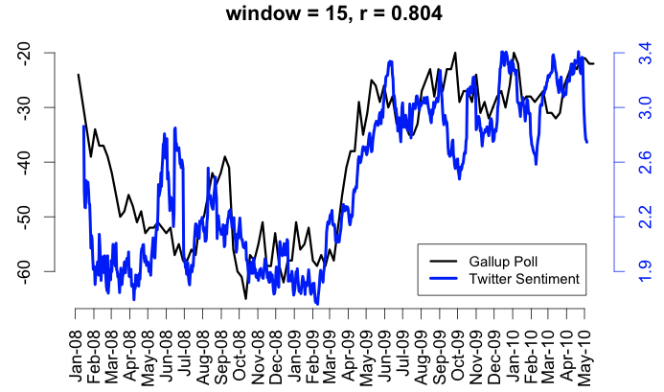
Tasks - Sentiment Analysis
Twitter sentiment versus Public Consumer Confidence
1 billion Twitter messages posted over the years 2008 and 2009
Brendan O'Connor, Ramnath Balasubramanyan, Bryan R. Routledge, and Noah A. Smith. 2010. From Tweets to Polls: Linking Text Sentiment to Public Opinion Time Series. In ICWSM-2010

Slide 16
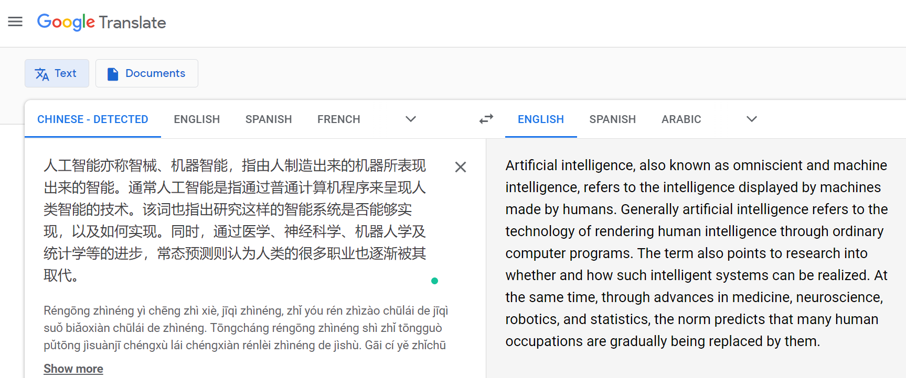
Tasks - Machine Translation

Slide 17
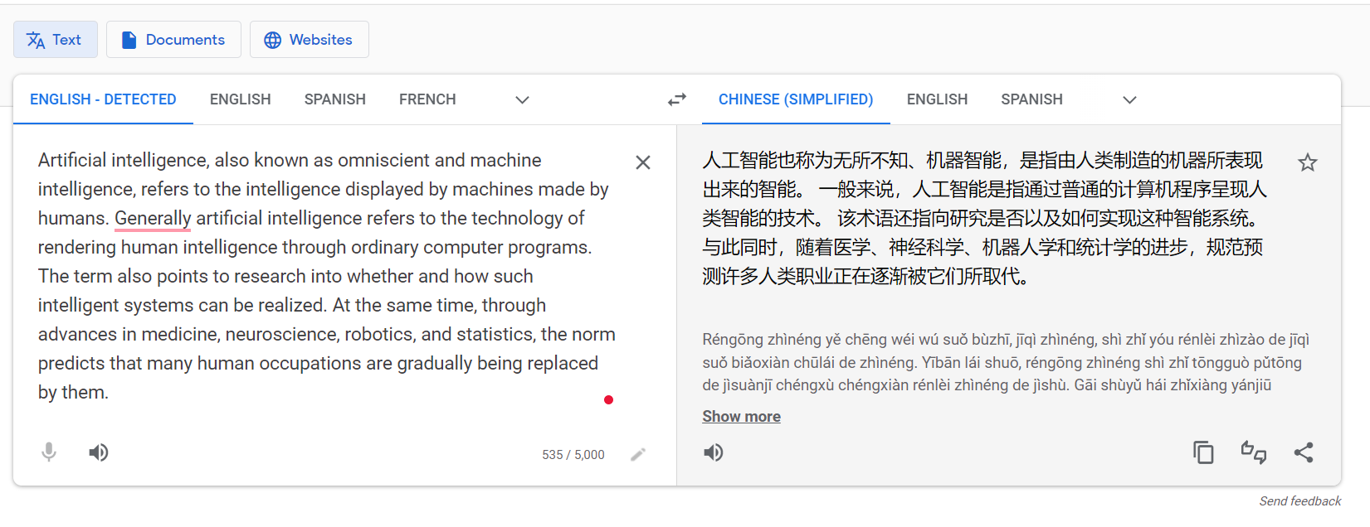
Tasks - Machine Translation

Slide 18
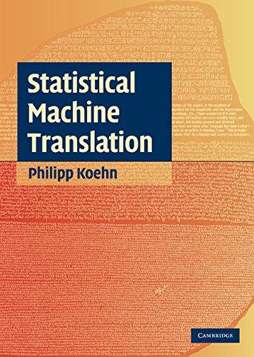
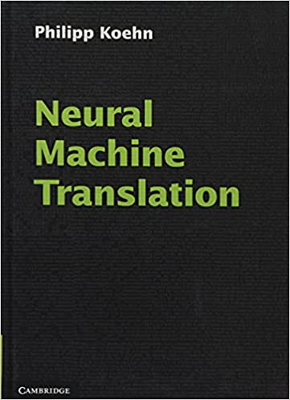
Tasks - Machine Translation
Warren Weaver on translation as code breaking (1947):
When I look at an article in Russian, I say: “This is really written in English, but it has been coded in some strange symbols. I will now proceed to decode”
Machine translation research started in the 1960s.
Statistical machine translation
Neural machine translation
?
1960
1990 – 2000
2015
Future

Slide 19
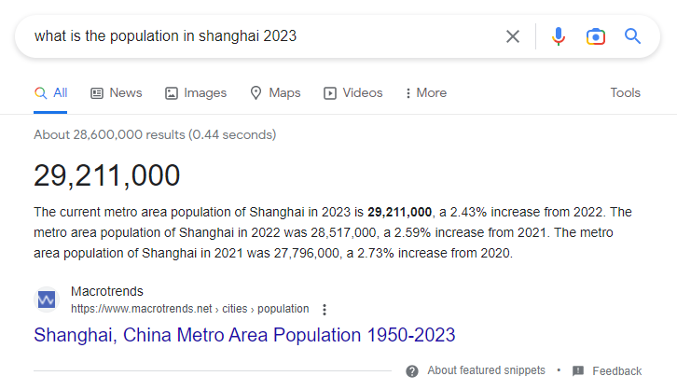
Tasks - Question Answering (QA)
QA provides answers to question directly
Advance version of information retrieval
Web Q/A

Slide 20
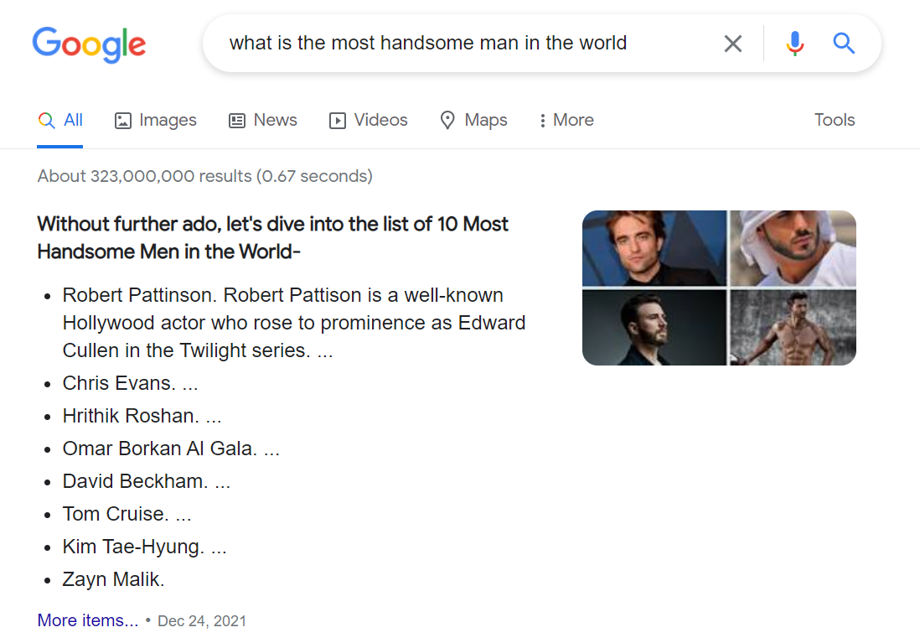
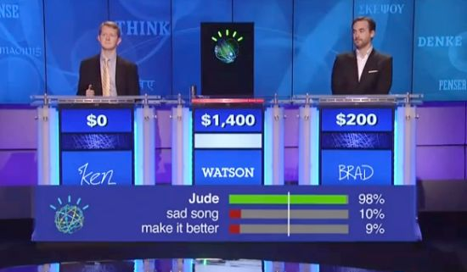
Tasks - QA
IBM Watson:
Won Jeopardy on February 16, 2011!
77,147 VS (21,600 and 24,000 from two top human players)
Q: 米洛拉德•查维奇几乎破坏了这个人的完美2008奥运，仅仅输给这个人百分之一秒。
A: 菲尔普斯。

Slide 21
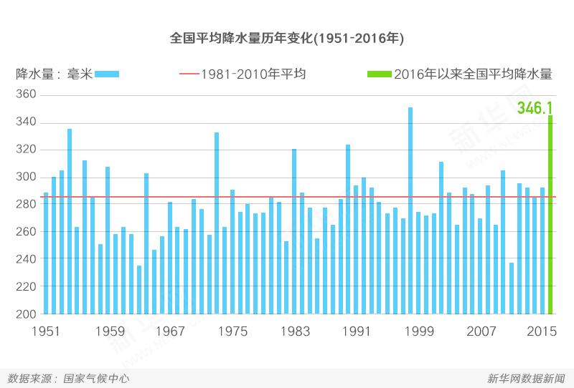
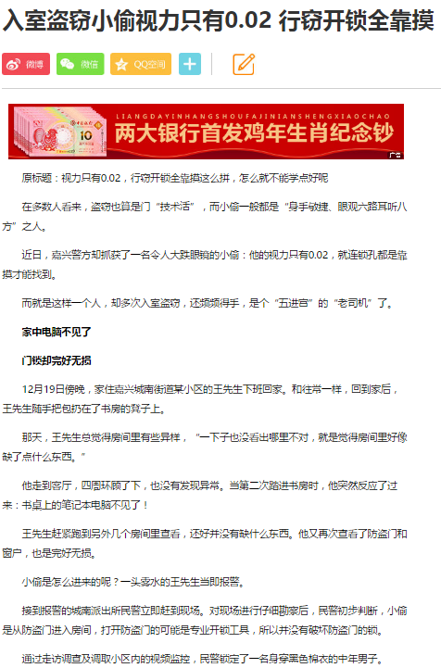
Tasks – Text Generation
text-to-text
data-to-text
image-to-text
Summarization
User Comment
News Re-writing
从1981年到2010年，全国平均降水量为280毫米 …
News
Comment
Conversation

Slide 22


Tasks – Text Generation
MSRA Couplet（对联生成） Generator
写稿机器人
https://aclanthology.org/D19-1637.pdf 七里香
Vernacular paragraph
窗外的麻雀在电线杆上多嘴，
你说这一句很有夏天的感觉。
手中的铅笔在纸上来来回回，
我用几行字形容你是我的谁。
Generated poem
窗下麻姑灯火多，
闲中说与万缘何。
夏频手把铅华纸，
来往回头用几多。

Slide 23
Tasks – Text Generation
A: Blog
Title: Feeling unproductive? Maybe you should stop overthinking.
Content: In order to get something done, maybe we need to think less. Seems counter-intuitive, but I believe sometimes our thoughts can get in the way of the creative process. We can work better at times when we "tune out" the external world and focus on what's in front of us. I've been thinking about this lately, so I thought it would be good to write an article about it…
B: News article
Title: United Methodists Agree to Historic Split
Content: After two days of intense debate, the United Methodist Church has agreed to a historic split - one that is expected to end in the creation of a new denomination, one that will be “theologically and socially conservative,” according to The Washington Post. The majority of delegates attending the church‘s annual General Conference in May voted to strengthen a ban on the ordination of LGBTQ clergy and to write new rules that will “discipline” clergy who officiate at same-sex weddings. But those who opposed these measures have a new plan…
A: Human Written B: Human Written
A: Machine Written B: Human Written
A: Human Written B: Machine Written
A: Machine Written B: Machine Written
They are all generated by GPT-3!

Slide 24
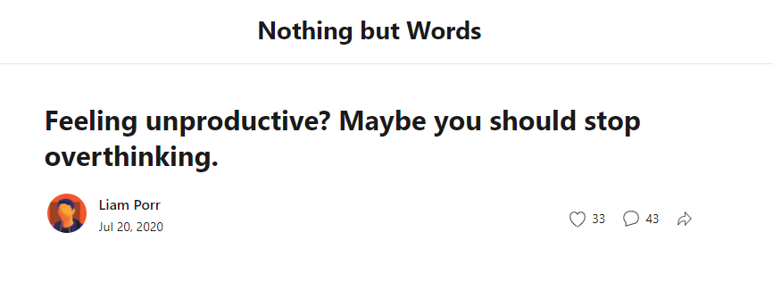
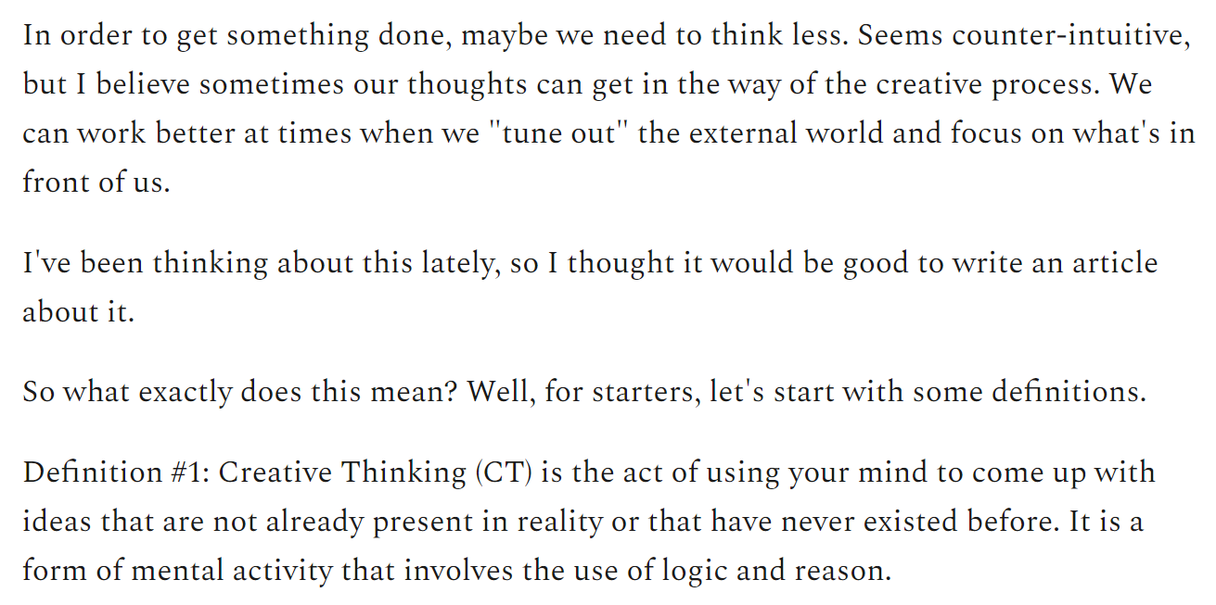
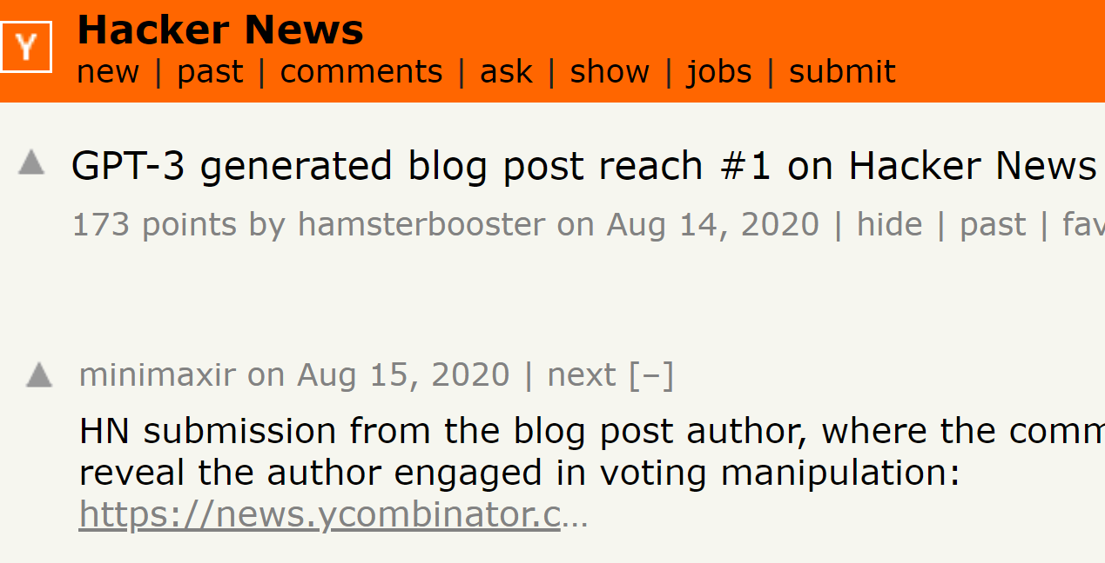
Tasks – Text Generation
GPT-3 generated blogs

Slide 25

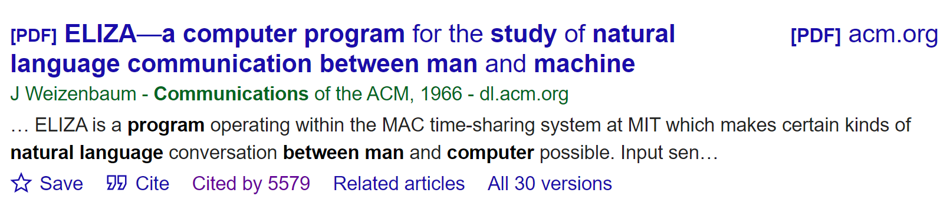
Applications - Chatbot
A: Men are all alike
B: In what way?
A: They're always bugging us about something or other.
B: Can you think of a specific example?
A: Well, my boyfriend made me come here.
B: Your boyfriend made you come here?
A: He says I'm depressed much of the time.
B: I’m sorry to hear you are depressed.
A: It’s true. I am unhappy.
B: Do you think coming here will help you not to be unhappy?
A: I need some help, that much seems certain.…
A: Human B: Human
A: Machine B: Human
A: Human B: Machine
A: Machine B: Machine
A: Human B: Machine

Slide 26
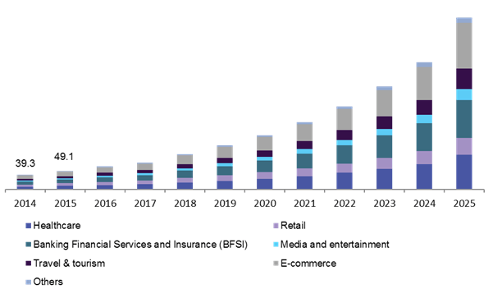

Applications - Chatbot
Good things:
24-hour availability
Instant answers
Recorded answers
Multi language
Personalization.
Bad things:
Not directing to an agent
Deploying the bot before it's ready
Misuse of proactive chat

Slide 27
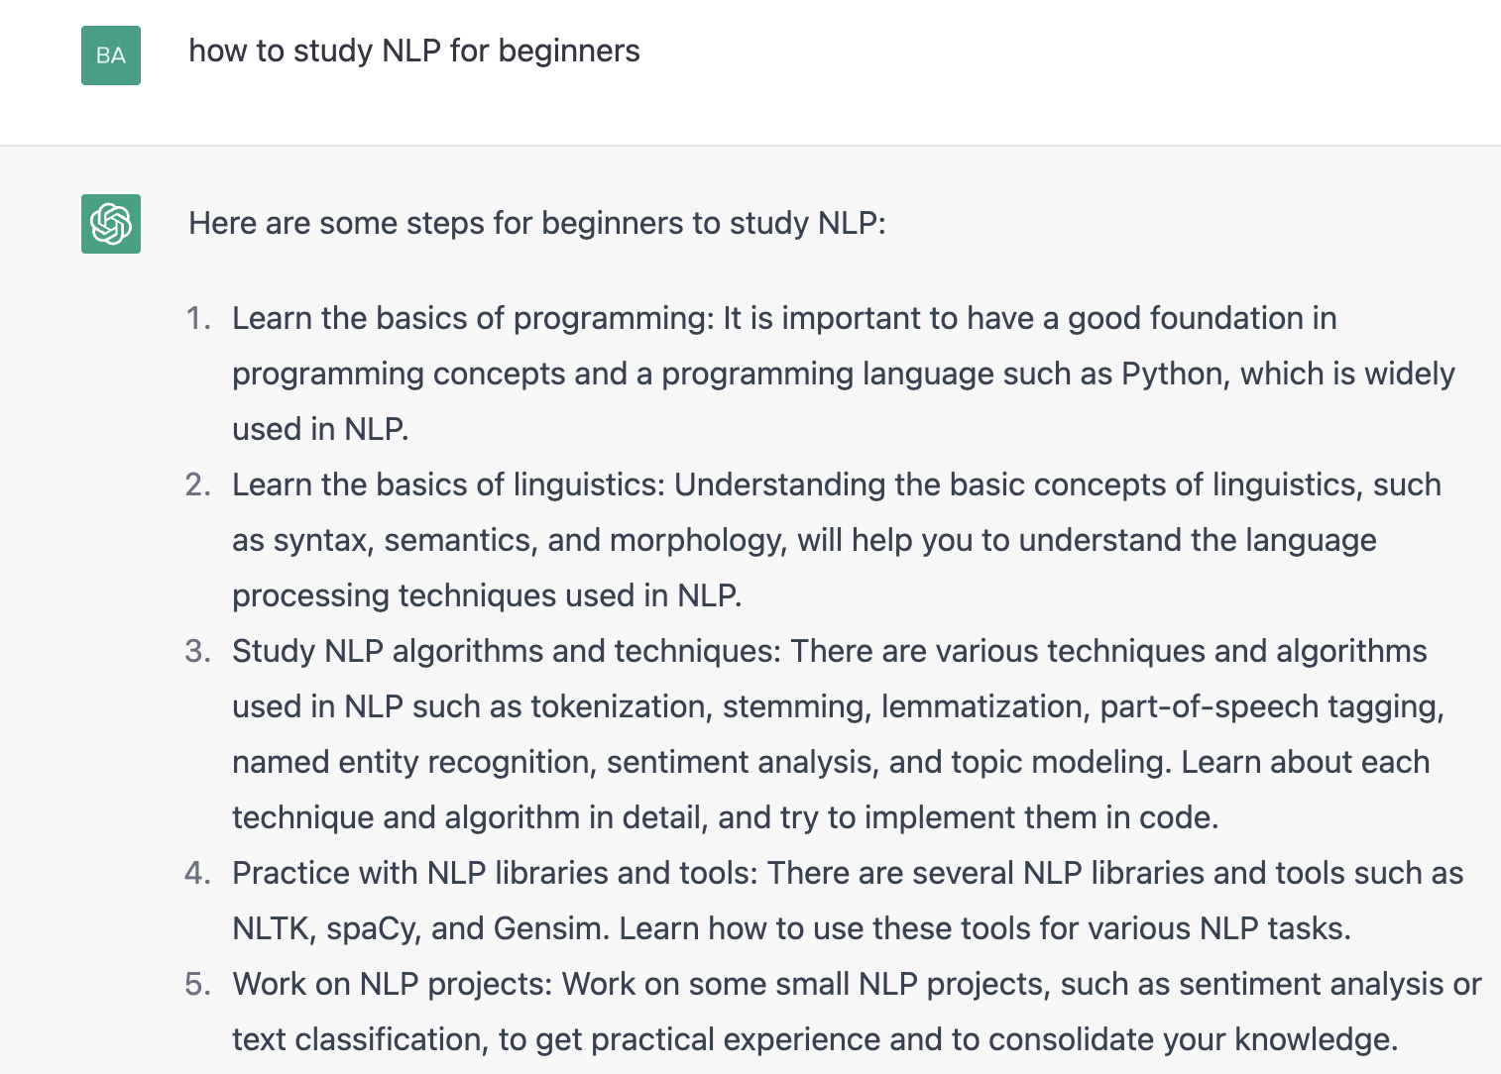
Applications - ChatGPT

Slide 28

Applications - ChatGPT

Slide 29


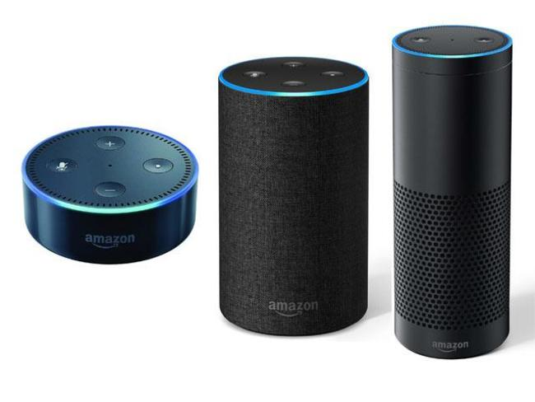

Many other products

Slide 30
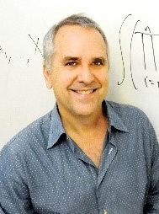
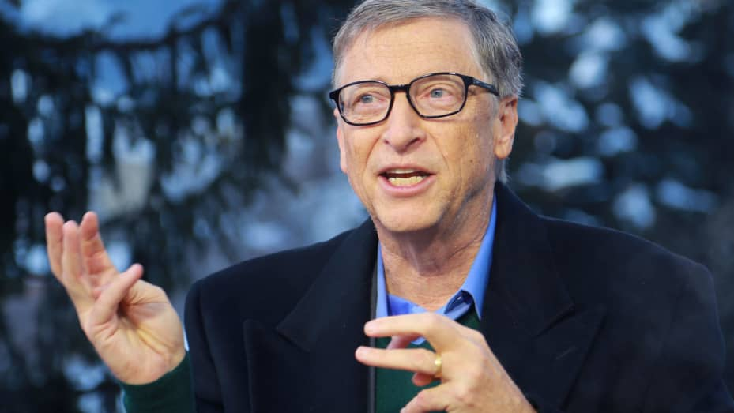
NLP is the future!
If I have 1 Billion dollars, I will build a research team focusing on Natural Language Processing
If I were starting a company today, it would use AI to teach computers how to read.

Slide 31

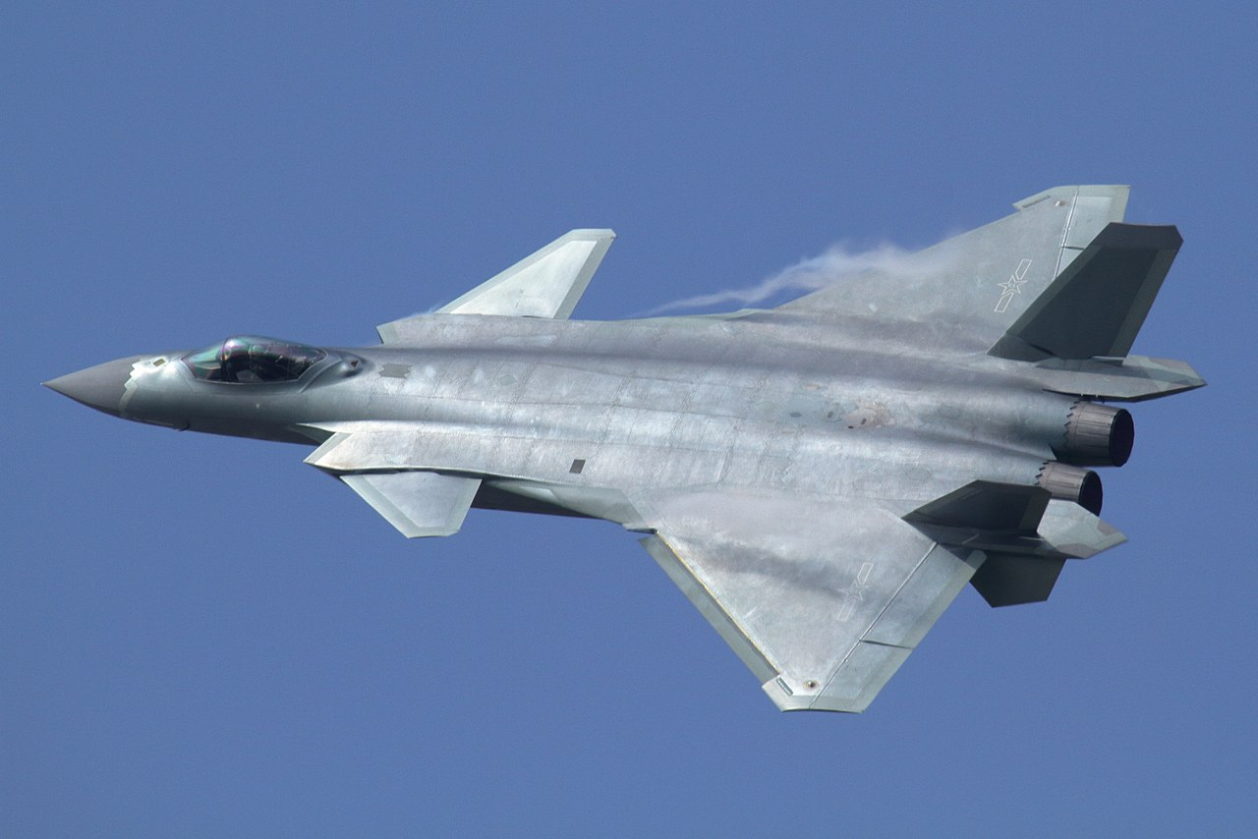

Ambiguity makes NLP hard
However, NLP is difficult!
“A man saw a boy with a telescope.”
Who had the telescope?
“He has quit smoking”
He smoked before.
What does the Mighty Dragon mean？

Slide 32
Ambiguities in English
Teacher strikes idle kids.
The chickens are too hot to eat.
The old men and women left the room.
He left her in tears.
Hospitals Are Sued by 6 foot doctors.

Slide 33
Ambiguities in Chinese
冬天，能穿多少穿多少；夏天，能穿多少穿多少；
剩女的原因：一是谁都看不上，二是谁都看不上；
单身的来由：原来是喜欢一个人，现在是喜欢一个人；
女致电男友：地铁站见。如果你到了我还没到，你就等着吧。如果我到了你还没到，你就等着吧！

Slide 34

Ambiguities in Chinese

Slide 35
Hard to inference
Example:
A dime is better than a nickel
A nickel is better than a penny
Therefore, a dime is better than a penny
Adversarial Example:
A penny is better than nothing
Nothing is better than world peace.
Therefore, a penny is better than world peace ???

Slide 36


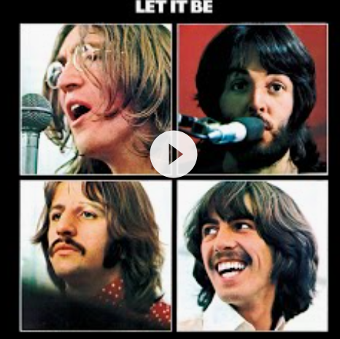
Other difficulties
Non-standard English
Segmentation issues
Idioms
Great job @justinbieber! Were SOO PROUD of what youve accomplished! U taught us 2 #neversaynever & you yourself should never give up either♥
dark horse
lose face
the New York-New Haven Railroad
the New York-New Haven Railroad
Neologisms
World knowledge
Tricky entity
unfriend
Retweet
bromance
鸡娃
Where is A Bug’s Life playing
Let It Be was recorded …
Mary and Sue are sisters.
Mary and Sue are mothers.
But that’s what makes it fun!

Slide 37
NLP Conferences
Natural Language Processing
ACL, EMNLP, COLING, NAACL, EACL (https://aclanthology.org/ )
Machine learning
ICML, NIPS, ICLR
Information Retrieval
SIGIR, WWW, CIKM, WSDM
Data Mining
KDD

Slide 38
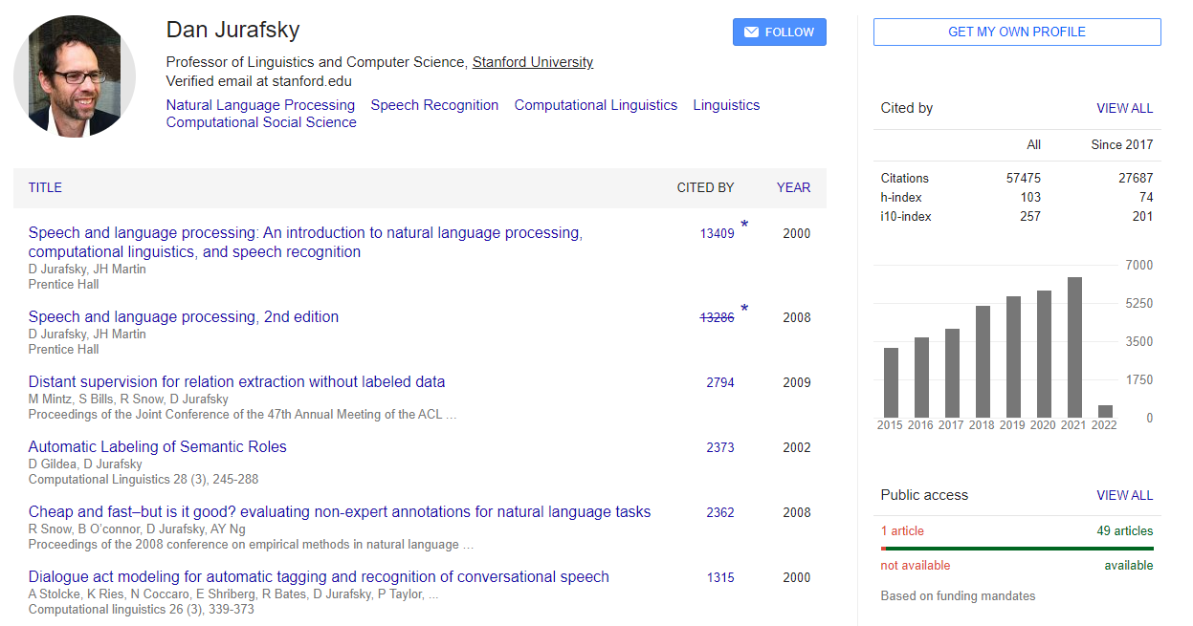
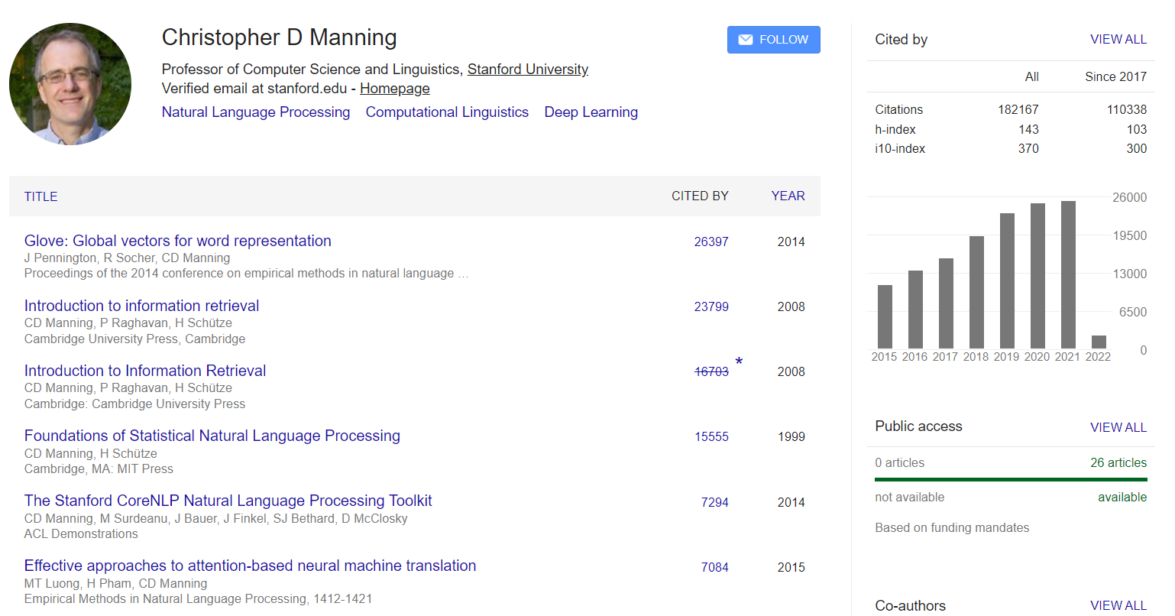
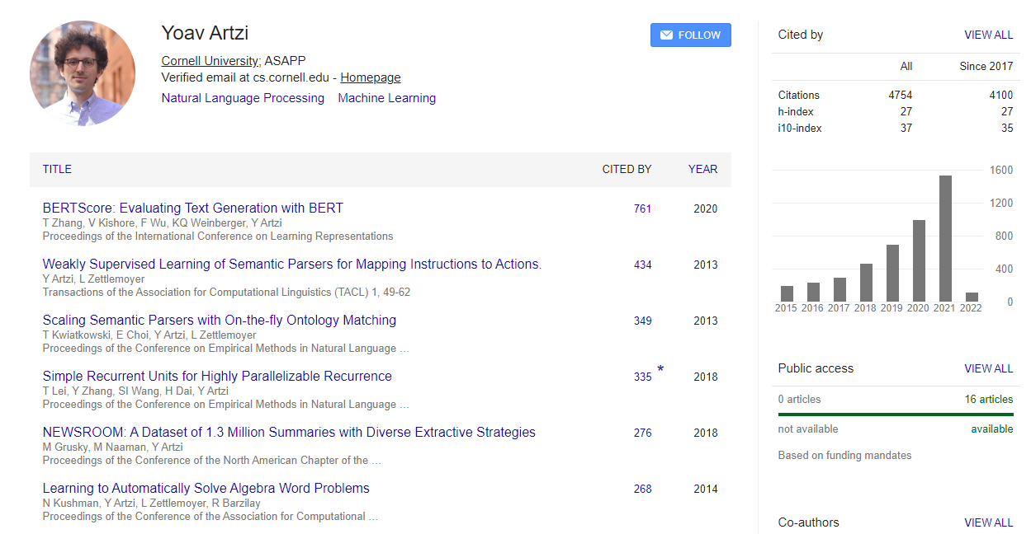
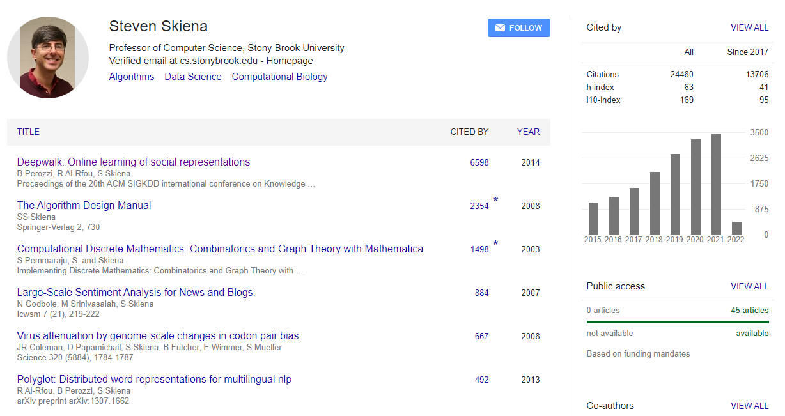
People in NLP

Slide 39
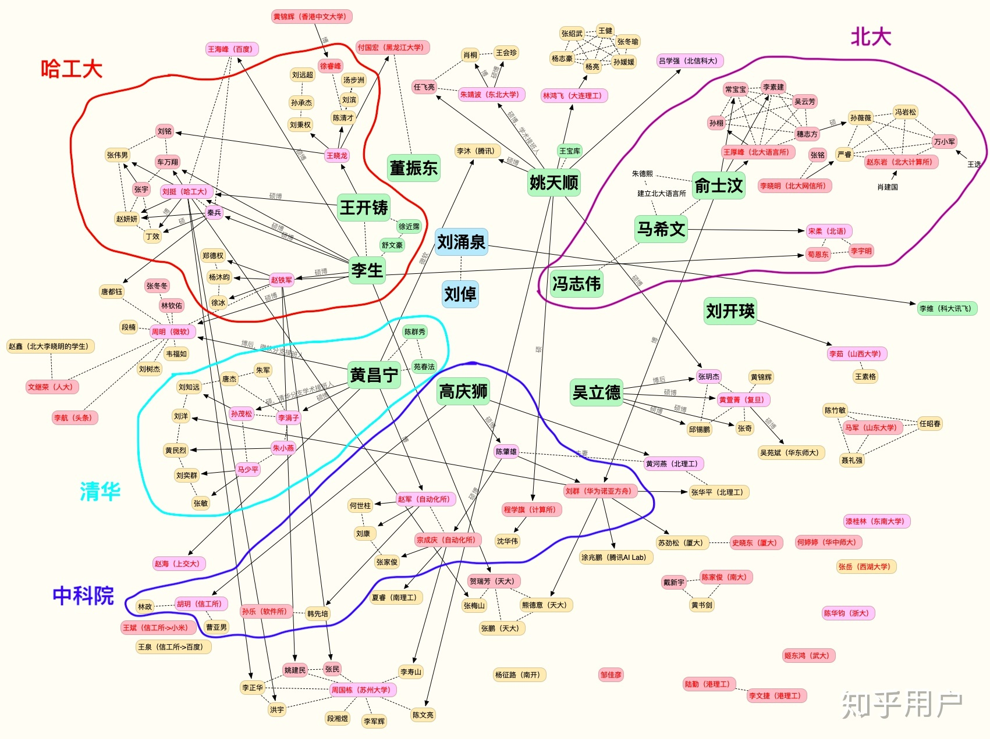
People in NLP (China)
知乎:
https://www.zhihu.com/question/24366306

Slide 40
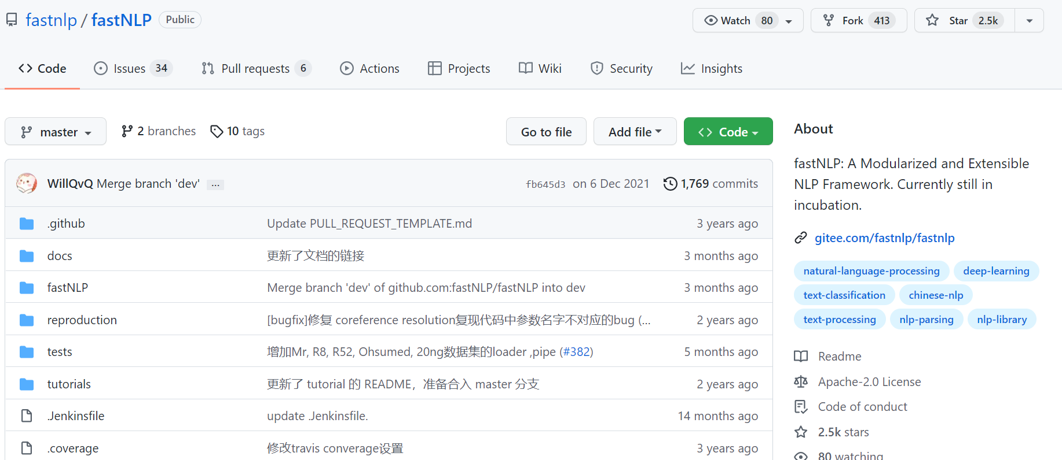
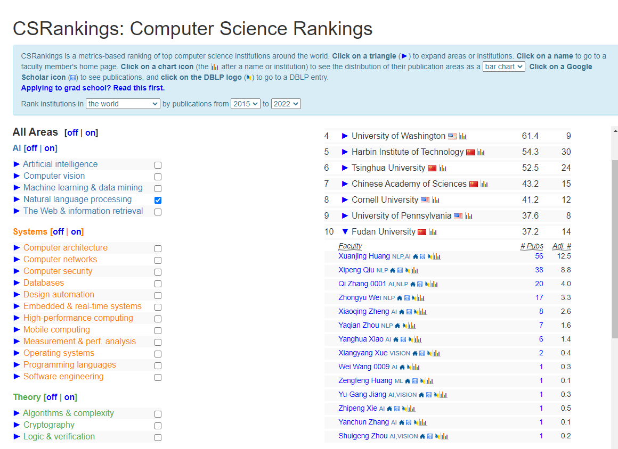

People in NLP (Fudan)
邱锡鹏老师的回答：
https://www.zhihu.com/question/24366306/answer/123787923

Slide 41
Research Labs
https://openai.com/research/ (Microsoft)
https://ai.googleblog.com/
https://deepmind.com/
https://ai.tencent.com/ailab/nlp/en/index.html
Facebook, Amazon, Baidu, Huawei
Many others

Slide 42
What we will cover?
Basic text pre-processing approaches
Language Models （语言模型）
Text classification （文本分类）
Word representation （单词向量表示）
Text clustering （文本聚类）
Sentiment analysis （情感分析）
Part-of-speech tagging （词性标注）
Text summarization （文本摘要）
Hidden Markov Model (隐马尔科夫模型)
Recurrent NN（递归神经网络），Attention

Slide 43
Skills needed/learned
Linear algebra (vectors, matrices)
Basic Statistics/Optimization
Machine Learning algorithms
Neural network models
Strong Python programming skills!
Communication skills

Slide 44
Textbooks
Dan Jurafsky and James H. Martin, Speech and Language Processing, https://web.stanford.edu/~jurafsky/slp3/（主要参考）
张奇、桂韬、黄萱菁，自然语言处理导论, https://intro-nlp.github.io/, 2022
Bird, Steven, Ewan Klein, and Edward Loper. Natural language processing with Python: analyzing text with the natural language toolkit." O'Reilly Media, Inc.", 2009. https://www.nltk.org/book/
Foundations of Statistical Natural Language Processing, https://nlp.stanford.edu/fsnlp/, 1999

Slide 45
Other Online Courses
Stanford CS 124: From Languages to Information, https://web.stanford.edu/class/cs124/
Stanford CS 276: Information Retrieval and Web Search, https://web.stanford.edu/class/cs276/
Stanford CS 224N: Deep learning for Natural language processing, https://web.stanford.edu/class/cs224n/
Stanford CS224W: Machine Learning with Graphs, https://web.stanford.edu/class/cs224w/

Slide 46

Coursework
Participation (5%)
Quizzes (10%)
Assignments (50 %)
Final Project (35 %)
Office hours
Lecturer: Baojian Zhou, Tue. 10:00-11:30am
TA: Zhen Chen（Schedule will be updated）
Submit to Fudan eLearning: https://elearning.fudan.edu.cn/
Integrity policy: http://xxgk.fudan.edu.cn/bd/61/c5163a48481/page.htm

Slide 47
Outline
Introduction to NLP
Basics for Python and NLTK
Regular Expression & Edit distance

Slide 48



Install Python & Tools
Python
https://www.python.org/downloads/ Python3.X
Python IDE
PyCharm - https://www.jetbrains.com/pycharm/
Jupyter - https://jupyter.org/
Spyder - https://www.spyder-ide.org/
Anaconda
https://www.anaconda.com/ (Strongly Recommended)
Git: https://github.com/ to manage your code

Slide 49
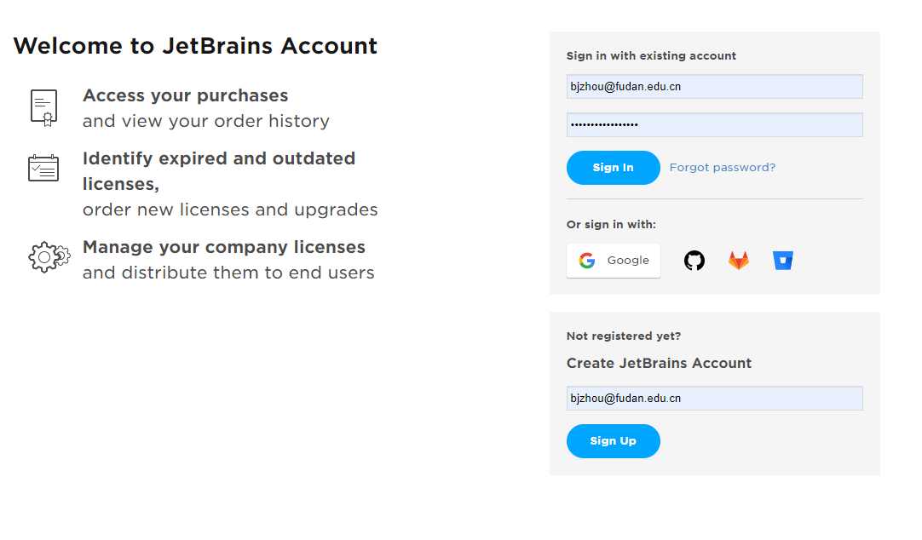
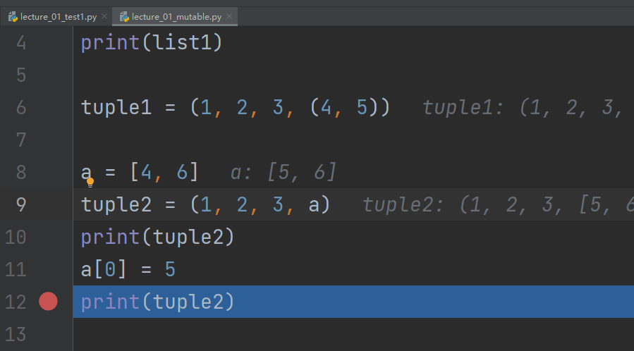
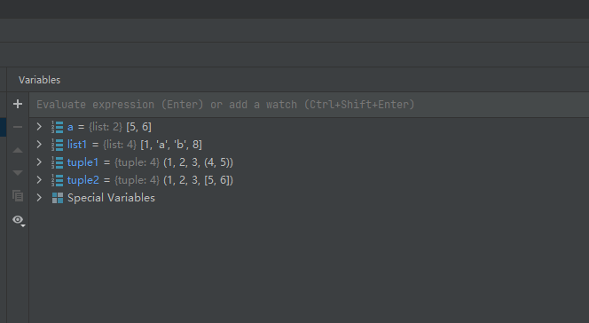
PyCharm is free for students
Use your fudan.edu.cn email account Debug on Pycharm

Slide 50
Install Anaconda
Download: https://docs.anaconda.com/anaconda/install/index.html
Activate: source /Users/baojian/opt/anaconda3/bin activate
Create env: conda create -n nlp-23 python=3.10
Activate env: conda activate nlp-23
Type python, you will go into nlp-23 env

Slide 51
Packages need to install
Python packages（This lecture: nltk, Jupyter, matplotlib）
Package 安装方法：
pip install –index [MirrorURL] [PackageName]
从阿里镜像下载并安装 matplotlib 包
pip install --index http://mirrors.aliyun.com/pypi/simple/ matplotlib
更多其他的镜像源：https://blog.csdn.net/yywan1314520/article/details/51045660
Use Package：
import nltk # get NLTK tool

Slide 52
Jupyter Notebook
Install: https://jupyter.org/install pip install notebook
Create a new Jupyter Notebook
Download some text data: https://www.nltk.org/data.html

Slide 53


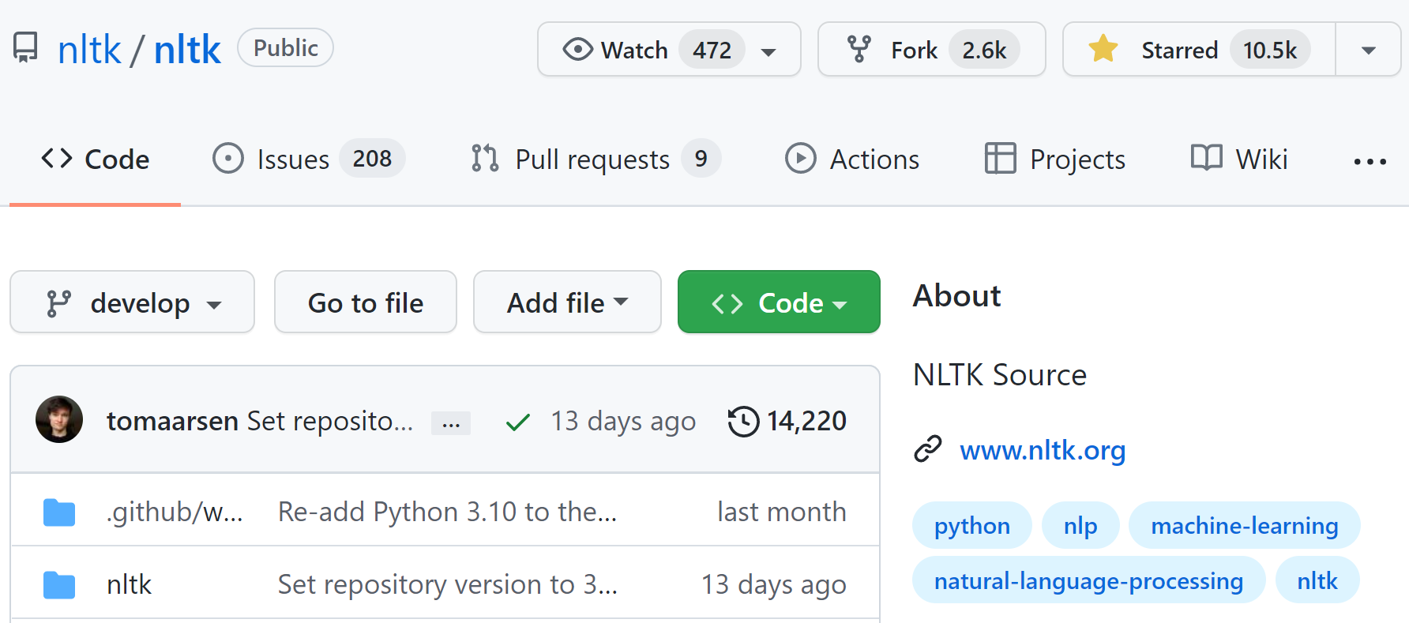
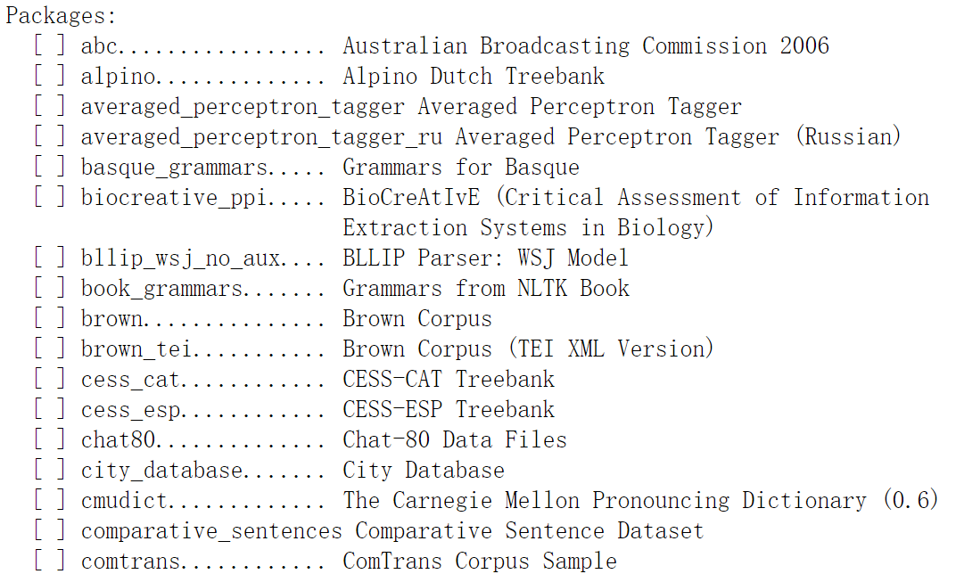
NLTK
Natural Language Toolkit
Developed by Steven Bird and Edward Loper
One of most popular tools for NLP

Slide 54

NLTK
NLTK collects many corpus

Slide 55

Tokenization
琼瑶阿姨的经典台词：
男：对，你无情，你残酷，你无理取闹！
女：那你就不无情，不残酷，不无理取闹！？
男：我哪里无情！？哪里残酷！？哪里无理取闹！？
女：你哪里不无情！？哪里不残酷！？哪里不无理取闹！？
男：我就算再怎么无情、再怎么残酷、再怎么无理取闹，也不会比你更无情、更残酷、更无理取闹！
女：我会比你无情！？比你残酷！？比你无理取闹！？你才是我见过最无情、最残酷、最无理取闹的人。
男：哼，我绝对没你无情，没你残酷，没你无理取闹！
女：好，既然你说我无情，我残酷，我无理取闹，我就无情给你看，残酷给你看，无理取闹给你看。
男：看吧，还说你不无情，不残酷，不无理取闹。现在完全展现你无情、残酷、无理取闹的一面了吧？！

Slide 56


Text searching
单词 monstrous 通常应用在什么样的语境中？

Slide 57

Text searching
与good用法相似的词汇，有哪些？
单词 good 与 great 通用的上下文情景有哪些？

Slide 58



Text searching
绘制特定词汇在文本中的分布图：text2语料，来自小说《理智与情感》(Sense and Sensibility) Elinor, Marianne, Edward, John 是小说中的四个角他们在小说中的出场情况如何呢？
Elinor Dashwood
Marianne Dashwood
Edward Ferrars
John Willoughby
Colonel Brandon

Slide 59




Text searching
Marianne Elinor
Willoughby
Edward

Slide 60
Python & NLTK Demonstration
Go to Elearning and download the Jupyter Notebook

Slide 61
Outline
Introduction to NLP
Basics for Python and NLTK
Regular Expression & Edit distance

Slide 62
Outline
Regular Expressions
Edit Distance

Slide 63

Regular expressions
A formal language for specifying text strings
How can we search for any of these?
woodchuck (土拨鼠)
woodchucks
Woodchuck
Woodchucks
Need a tool to help us

Slide 64

Regular expressions
A regular expression is a function!
Regular expression，
(e.g., r“\w+(?:[-‘]\w+)*|’|[-.(]+|\S\w*“)
A String
Matched string
$\text{Matched}\text{ =} f(string)$, where $f$ is a regular exp.

Slide 65


RE: Disjunctions
Letters inside square brackets []
Ranges [A-Z]
Pattern | Matches
[wW]oodchuck | Woodchuck, woodchuck
[1234567890] | Any digit
Pattern | Matches | Example String
[A-Z] | An upper case letter | Drenched Blossoms
[a-z] | A lower case letter | my beans were impatient
[0-9] | A single digit | Chapter 1: Down the Rabbit Hole

Slide 66


RE: Negation in Disjunction
Negations: e.g., [^Ss]
Caret (脱字符): negation only when first in []
Pattern | Matches | Example String
[^A-Z] | Not an upper case letter | Oyfn pripetchik
[^Ss] | Neither ‘S’ nor ‘s’ | I have no exquisite reason”
[^e^] | Neither e nor ^ | Look here
a\^b | The pattern a carat b | Look up a^b now

Slide 67
RE: More Disjunction
Woodchucks is another name for groundhog!
The pipe | for disjunction
Pattern | Matches
groundhog|woodchuck | groundhog and woodchuck
yours|mine | yours mine
a|b|c | = [abc]
[gG]roundhog|[Ww]oodchuck | ???

Slide 68


RE: ? * + .
Pattern | Matches | Matched examples
colou?r | Optional previous char | color colour
oo*h! | 0 or more of previous char | oh! ooh! oooh! ooooh!
o+h! | 1 or more of previous char | oh! ooh! oooh! ooooh!
baa+ | 1 or more of previous char | baa baaa baaaa baaaaa
beg.n | any char | begin begun begun beg3n

Slide 69
RE: Anchors ^ $
Pattern | Matches
^[A-Z] | Palo Alto
^[^A-Za-z] | 1 “Hello”
\.$ | The end.
.$ | The end? The end!

Slide 70
Example: Find all “the” in a text
Find me all instances of the word “the” in a text.
the
Misses capitalized examples
[tT]he
Incorrectly returns other or theology
[^a-zA-Z][tT]he[^a-zA-Z]
More on Regular Expression: Chapter 3 on Natural Language Processing with Python http://www.nltk.org/book/ch03.html

Slide 71

RE: Real-world example
Use the following RE in Python to extract links from Wikipedia dump:
\[\[(?P<link>[ˆ\n\|\]\[\<\>\{\}]{0,256})(?:\|(?P<anchor>[ˆ\[]*?))?\]\]
Consonni, Cristian, David Laniado, and Alberto Montresor. "WikiLinkGraphs: a complete, longitudinal and multi-language dataset of the Wikipedia link networks." Proceedings of the International AAAI Conference on Web and Social Media. Vol. 13. 2019.

Slide 72
Outline
Regular Expressions
Edit Distance
Definition of Minimum Edit Distance
Computing Minimum Edit Distance

Slide 73
How similar are two strings?
Spell correction
The user typed “graffe”. Given candidate set {graf graft grail giraffe}
Which is closest?
Computational Biology
Align two sequences of nucleotides
Resulting alignment
AGGCTATCACCTGACCTCCAGGCCGATGCCC
TAGCTATCACGACCGCGGTCGATTTGCCCGAC
-AGGCTATCACCTGACCTCCAGGCCGA--TGCCC---
TAG-CTATCAC--GACCGC--GGTCGATTTGCCCGAC

Slide 74
How similar are two strings? (Continued)
Machine Translation (Task: Chinese -> English)
Chinese: 这个机场的安全工作由以色列方面负责
Reference: Israel officials are responsible for airport security
Model 1: Israel officials responsibility of airport safety
Model 2: Israel is responsible for safety work at this airport
Model 3: Israel presides over the security of the airport
Model 4: Israel took charge of the airport security
Which translation model is the best?

Slide 75
Minimum Edit Distance
The minimum edit distance between two strings
String X -> String Y
Is the minimum number of editing operations
Insertion (i)
Deletion (d)
Substitution (s)
Transform String X into String Y

Slide 76
Minimum Edit Distance (MED)
Two strings and their alignment
String X = INTENTION
String Y = EXECUTION
If each operation has cost of 1
Distance between X and Y is 5
If substitutions cost 2
Distance between X and Y is 8
I
N
T
E
*
N
T
I
O
N
Deletion
*
E
X
E
C
U
T
I
O
N
Substitution
Insertion

Slide 77
How to find MED?
Searching for a path (sequence of edits) from the start string to the final string:
Initial state: the word we’re transforming
Operators: insert, delete, substitute
Goal state: the word we’re trying to get to
Path cost: the number of weighted edits
Number of edit sequences is huge
Don’t have to track of all of them
Just the shortest path to each of those revisited states.
INTENTION
Del
Ins
Sub
NTENTION
EINTENTION
ENTENTION

Slide 78

Defining MED
For two strings, define
$X$ of length $n$: $X=\left[x_{1},x_{2},…, x_{n}\right]$
$Y$ of length $m$: $Y=\left[y_{1},y_{2},…, y_{m}\right]$
We define $D[i,j]$
The minimum edit distance between $X[1…i]$ and $Y[1…j]$
$i$: the first $i$ characters of $X$
$j$: the first $j$ characters of $Y$
The edit distance between $X$ and $Y$ is thus $D[n,m]$

Slide 79

Dynamic Programming for MED
Dynamic programming: A tabular computation of $D[i,j]$
Solving problems by combining solutions to subproblems.
Bottom-up
Compute $D[i,j]$ for small $i,j$ $\left(i=0, j=0\right)$
Compute larger $D[i,j]$ based on previously computed entries
$D[i,j]$ for all $i=1,2,…n$ and $j=1,2,…,m$

Slide 80


MED (Levenshtein)
Initialization
$D\left[i,j\right]=j, for i=0$
$D\left[i,j\right]=i, for j=0$
Recurrence Relation
For each $i=1,2,…,n$
For each $j=1,2,…,m$
$$D\left[i,j\right]=\min\left\{\begin{aligned}D\left[i−1,j\right]+Del\left(x_{i}\right) \\ D\left[i,j−1\right]+Ins(y_{i}) \\ D\left[i−1,j−1\right]+Sub\left(x_{i},y_{i}\right)\end{aligned} \right.$$
Termination return $D\left[n,m\right]$ as MED
Levenshtein Distance
$Del\left(x_{i}\right)=1$
$Ins\left(y_{i}\right)=1$
$Sub\left(x_{i},y_{i}\right)=\left\{\begin{aligned}2 x_{i}≠y_{i} \\ 0 x_{i}=y_{i}\end{aligned}\right.$

Slide 81


MED Table: Initialization
N | 9
O | 8
I | 7
T | 6
N | 5
E | 4
T | 3
N | 2
I | 1
# | 0 | 1 | 2 | 3 | 4 | 5 | 6 | 7 | 8 | 9
 | # | E | X | E | C | U | T | I | O | N
$$i=0$$
$$j=0$$

Slide 82



MED Table: Second column
N | 9
O | 8
I | 7
T | 6
N | 5
E | 4
T | 3
N | 2
I | 1
# | 0 | 1 | 2 | 3 | 4 | 5 | 6 | 7 | 8 | 9
 | # | E | X | E | C | U | T | I | O | N
$$D\left[i,j\right]=\min\left\{\begin{aligned}D\left[i−1,j\right]+Del\left(x_{i}\right) \\ D\left[i,j−1\right]+Ins(y_{i}) \\ D\left[i−1,j−1\right]+Sub\left(x_{i},y_{i}\right)\end{aligned} \right.$$
$$i=1$$
?
$$j=1$$

Slide 83


MED Table: Second column
N | 9
O | 8
I | 7
T | 6
N | 5
E | 4
T | 3
N | 2
I | 1 | 2
# | 0 | 1 | 2 | 3 | 4 | 5 | 6 | 7 | 8 | 9
 | # | E | X | E | C | U | T | I | O | N
$$D\left[i,j\right]=\min\left\{\begin{aligned}D\left[i−1,j\right]+Del\left(x_{i}\right) \\ D\left[i,j−1\right]+Ins(y_{i}) \\ D\left[i−1,j−1\right]+Sub\left(x_{i},y_{i}\right)\end{aligned} \right.$$
Substitution
$$i=1$$
$$j=1$$

Slide 84


MED Table: Second column
N | 9
O | 8
I | 7
T | 6
N | 5
E | 4 | ?
T | 3 | 4
N | 2 | 3
I | 1 | 2
# | 0 | 1 | 2 | 3 | 4 | 5 | 6 | 7 | 8 | 9
 | # | E | X | E | C | U | T | I | O | N
$$D\left[i,j\right]=\min\left\{\begin{aligned}D\left[i−1,j\right]+Del\left(x_{i}\right) \\ D\left[i,j−1\right]+Ins(y_{i}) \\ D\left[i−1,j−1\right]+Sub\left(x_{i},y_{i}\right)\end{aligned} \right.$$
$$i=4$$
$$j=1$$

Slide 85


MED Table: Second column
N | 9
O | 8
I | 7
T | 6
N | 5
E | 4 | 3
T | 3 | 4
N | 2 | 3
I | 1 | 2
# | 0 | 1 | 2 | 3 | 4 | 5 | 6 | 7 | 8 | 9
 | # | E | X | E | C | U | T | I | O | N
$$D\left[i,j\right]=\min\left\{\begin{aligned}D\left[i−1,j\right]+Del\left(x_{i}\right) \\ D\left[i,j−1\right]+Ins(y_{i}) \\ D\left[i−1,j−1\right]+Sub\left(x_{i},y_{i}\right)\end{aligned} \right.$$
Unchanged
$$i=4$$
$$j=1$$

Slide 86
Final MED Table
N | 9 | 8 | 9 | 10 | 11 | 12 | 11 | 10 | 9 | 8
O | 8 | 7 | 8 | 9 | 10 | 11 | 10 | 9 | 8 | 9
I | 7 | 6 | 7 | 8 | 9 | 10 | 9 | 8 | 9 | 10
T | 6 | 5 | 6 | 7 | 8 | 9 | 8 | 9 | 10 | 11
N | 5 | 4 | 5 | 6 | 7 | 8 | 9 | 10 | 11 | 10
E | 4 | 3 | 4 | 5 | 6 | 7 | 8 | 9 | 10 | 9
T | 3 | 4 | 5 | 6 | 7 | 8 | 7 | 8 | 9 | 8
N | 2 | 3 | 4 | 5 | 6 | 7 | 8 | 7 | 8 | 7
I | 1 | 2 | 3 | 4 | 5 | 6 | 7 | 6 | 7 | 8
# | 0 | 1 | 2 | 3 | 4 | 5 | 6 | 7 | 8 | 9
 | # | E | X | E | C | U | T | I | O | N

Slide 87
Outline
Regular Expressions
Edit Distance
Definition of Minimum Edit Distance
Computing Minimum Edit Distance
Backtrace for Computing Alignments

Slide 88
Computing alignments
Edit distance is not sufficient
Need to align each character of the two strings to each other
Keep a “backtrace”
Every time we enter a cell, remember where we came from
When we reach the end,
Trace back the path from the upper right to read off the alignment

Slide 89



Computing Alignment
$$i=9$$
N | 9 | 8 | 9 | 10 | 11 | 12 | 11 | 10 | 9 | 8
O | 8 | 7 | 8 | 9 | 10 | 11 | 10 | 9 | 8 | 9
I | 7 | 6 | 7 | 8 | 9 | 10 | 9 | 8 | 9 | 10
T | 6 | 5 | 6 | 7 | 8 | 9 | 8 | 9 | 10 | 11
N | 5 | 4 | 5 | 6 | 7 | 8 | 9 | 10 | 11 | 10
E | 4 | 3 | 4 | 5 | 6 | 7 | 8 | 9 | 10 | 9
T | 3 | 4 | 5 | 6 | 7 | 8 | 7 | 8 | 9 | 8
N | 2 | 3 | 4 | 5 | 6 | 7 | 8 | 7 | 8 | 7
I | 1 | 2 | 3 | 4 | 5 | 6 | 7 | 6 | 7 | 8
# | 0 | 1 | 2 | 3 | 4 | 5 | 6 | 7 | 8 | 9
 | # | E | X | E | C | U | T | I | O | N
Start at end; at each step, ask which predecessor gave the minimum?
$D\left[i−1,j−1\right]+Sub\left(x_{i},y_{i}\right)==D\left[i,j\right]$
$D\left[i−1,j\right]+Del\left(x_{i}\right)==D\left[i,j\right]$
$D\left[i,j−1\right]+Ins\left(y_{i}\right)==D\left[i,j\right]$
$$j=9$$

Slide 90


Computing Alignment
N | 9 | 8 | 9 | 10 | 11 | 12 | 11 | 10 | 9 | 8
O | 8 | 7 | 8 | 9 | 10 | 11 | 10 | 9 | 8 | 9
I | 7 | 6 | 7 | 8 | 9 | 10 | 9 | 8 | 9 | 10
T | 6 | 5 | 6 | 7 | 8 | 9 | 8 | 9 | 10 | 11
N | 5 | 4 | 5 | 6 | 7 | 8 | 9 | 10 | 11 | 10
E | 4 | 3 | 4 | 5 | 6 | 7 | 8 | 9 | 10 | 9
T | 3 | 4 | 5 | 6 | 7 | 8 | 7 | 8 | 9 | 8
N | 2 | 3 | 4 | 5 | 6 | 7 | 8 | 7 | 8 | 7
I | 1 | 2 | 3 | 4 | 5 | 6 | 7 | 6 | 7 | 8
# | 0 | 1 | 2 | 3 | 4 | 5 | 6 | 7 | 8 | 9
 | # | E | X | E | C | U | T | I | O | N
Start at end; at each step, ask which predecessor gave the minimum?
$D\left[i−1,j−1\right]+Sub\left(x_{i},y_{i}\right)==D\left[i,j\right]$
$D\left[i−1,j\right]+Del\left(x_{i}\right)==D\left[i,j\right]$
$D\left[i,j−1\right]+Ins\left(y_{i}\right)==D\left[i,j\right]$
$$i=5$$
$$j=5$$

Slide 91


Computing Alignment
N | 9 | 8 | 9 | 10 | 11 | 12 | 11 | 10 | 9 | 8
O | 8 | 7 | 8 | 9 | 10 | 11 | 10 | 9 | 8 | 9
I | 7 | 6 | 7 | 8 | 9 | 10 | 9 | 8 | 9 | 10
T | 6 | 5 | 6 | 7 | 8 | 9 | 8 | 9 | 10 | 11
N | 5 | 4 | 5 | 6 | 7 | 8 | 9 | 10 | 11 | 10
E | 4 | 3 | 4 | 5 | 6 | 7 | 8 | 9 | 10 | 9
T | 3 | 4 | 5 | 6 | 7 | 8 | 7 | 8 | 9 | 8
N | 2 | 3 | 4 | 5 | 6 | 7 | 8 | 7 | 8 | 7
I | 1 | 2 | 3 | 4 | 5 | 6 | 7 | 6 | 7 | 8
# | 0 | 1 | 2 | 3 | 4 | 5 | 6 | 7 | 8 | 9
 | # | E | X | E | C | U | T | I | O | N
Start at end; at each step, ask which predecessor gave the minimum?
$D\left[i−1,j−1\right]+Sub\left(x_{i},y_{i}\right)==D\left[i,j\right]$
$D\left[i−1,j\right]+Del\left(x_{i}\right)==D\left[i,j\right]$
$D\left[i,j−1\right]+Ins\left(y_{i}\right)==D\left[i,j\right]$
$$i=4$$
$$j=4$$

Slide 92


Computing Alignment
N | 9 | 8 | 9 | 10 | 11 | 12 | 11 | 10 | 9 | 8
O | 8 | 7 | 8 | 9 | 10 | 11 | 10 | 9 | 8 | 9
I | 7 | 6 | 7 | 8 | 9 | 10 | 9 | 8 | 9 | 10
T | 6 | 5 | 6 | 7 | 8 | 9 | 8 | 9 | 10 | 11
N | 5 | 4 | 5 | 6 | 7 | 8 | 9 | 10 | 11 | 10
E | 4 | 3 | 4 | 5 | 6 | 7 | 8 | 9 | 10 | 9
T | 3 | 4 | 5 | 6 | 7 | 8 | 7 | 8 | 9 | 8
N | 2 | 3 | 4 | 5 | 6 | 7 | 8 | 7 | 8 | 7
I | 1 | 2 | 3 | 4 | 5 | 6 | 7 | 6 | 7 | 8
# | 0 | 1 | 2 | 3 | 4 | 5 | 6 | 7 | 8 | 9
 | # | E | X | E | C | U | T | I | O | N
Start at end; at each step, ask which predecessor gave the minimum?
$D\left[i−1,j−1\right]+Sub\left(x_{i},y_{i}\right)==D\left[i,j\right]$
$D\left[i−1,j\right]+Del\left(x_{i}\right)==D\left[i,j\right]$
$D\left[i,j−1\right]+Ins\left(y_{i}\right)==D\left[i,j\right]$
$$i=4$$
$$j=3$$

Slide 93

Computing Alignment
N | 9 | 8 | 9 | 10 | 11 | 12 | 11 | 10 | 9 | 8
O | 8 | 7 | 8 | 9 | 10 | 11 | 10 | 9 | 8 | 9
I | 7 | 6 | 7 | 8 | 9 | 10 | 9 | 8 | 9 | 10
T | 6 | 5 | 6 | 7 | 8 | 9 | 8 | 9 | 10 | 11
N | 5 | 4 | 5 | 6 | 7 | 8 | 9 | 10 | 11 | 10
E | 4 | 3 | 4 | 5 | 6 | 7 | 8 | 9 | 10 | 9
T | 3 | 4 | 5 | 6 | 7 | 8 | 7 | 8 | 9 | 8
N | 2 | 3 | 4 | 5 | 6 | 7 | 8 | 7 | 8 | 7
I | 1 | 2 | 3 | 4 | 5 | 6 | 7 | 6 | 7 | 8
# | 0 | 1 | 2 | 3 | 4 | 5 | 6 | 7 | 8 | 9
 | # | E | X | E | C | U | T | I | O | N
Start at end; at each step, ask which predecessor gave the minimum?
$D\left[i−1,j−1\right]+Sub\left(x_{i},y_{i}\right)==D\left[i,j\right]$
$D\left[i−1,j\right]+Del\left(x_{i}\right)==D\left[i,j\right]$
$D\left[i,j−1\right]+Ins\left(y_{i}\right)==D\left[i,j\right]$
$$i=1$$
$$j=0$$

Slide 94


Computing Alignment
N | 9 | 8 | 9 | 10 | 11 | 12 | 11 | 10 | 9 | 8
O | 8 | 7 | 8 | 9 | 10 | 11 | 10 | 9 | 8 | 9
I | 7 | 6 | 7 | 8 | 9 | 10 | 9 | 8 | 9 | 10
T | 6 | 5 | 6 | 7 | 8 | 9 | 8 | 9 | 10 | 11
N | 5 | 4 | 5 | 6 | 7 | 8 | 9 | 10 | 11 | 10
E | 4 | 3 | 4 | 5 | 6 | 7 | 8 | 9 | 10 | 9
T | 3 | 4 | 5 | 6 | 7 | 8 | 7 | 8 | 9 | 8
N | 2 | 3 | 4 | 5 | 6 | 7 | 8 | 7 | 8 | 7
I | 1 | 2 | 3 | 4 | 5 | 6 | 7 | 6 | 7 | 8
# | 0 | 1 | 2 | 3 | 4 | 5 | 6 | 7 | 8 | 9
 | # | E | X | E | C | U | T | I | O | N
Start at end; at each step, ask which predecessor gave the minimum?
$D\left[i−1,j−1\right]+Sub\left(x_{i},y_{i}\right)==D\left[i,j\right]$
$D\left[i−1,j\right]+Del\left(x_{i}\right)==D\left[i,j\right]$
$D\left[i,j−1\right]+Ins\left(y_{i}\right)==D\left[i,j\right]$
When $\left(i,j\right)==\left(0,0\right)$ Stop
I
N
T
E
*
N
T
I
O
N
$$i=0$$
*
E
X
E
C
U
T
I
O
N
$$j=0$$

Slide 95




Computing Alignment - Properties
When entering a value in each cell, we mark which of the three neighboring cells we came from with up to three arrows.
Every non-decreasing path from $(0,0)$to $(n,m)$ corresponds to an alignment of the two sequences.
An optimal alignment is composed of optimal subalignments.
DP, time: $O(nm)$ space: $O(nm)$
Backtrace, time and space: 𝑂(𝑛+𝑚)
$x0$ …………………… $x_{n}$
$y0$ ……………………………… $y_{m}$

Slide 96

Weighted Edit Distance - Weighted
Why would we add weights to the computation? Example, Spell Correction: some letters are more likely to be mistyped than others
Confusion matrix for spelling errors

Slide 97
Summary
Introduction to NLP
Tools for NLP: Python and NLTK
Regular expression
Minimum edit distance

Slide 98
References
[1] 张奇、桂韬、黄萱菁，自然语言处理导论，https://intro-nlp.github.io/, 2022.
[2] https://learn.microsoft.com/en-us/azure/architecture/data-guide/technology-choices/natural-language-processing

Slide 99
Exercises and readings
Register a ChatGPT account if you have not done yet, see instruction: https://www.yanlutong.com/gonglue/30511.html
For NLP and Python beginners: Alice Zhao, Natural Language Processing in Python, https://www.youtube.com/watch?v=xvqsFTUsOmc&t=1607s
Implement minimum edit distance and backtrack algorithm
Read and practice
https://www.nltk.org/book/ch01.html
https://www.nltk.org/book/ch02.html
Next lecture: N-gram language model

